Slide 1

CSE 408
Software Development Sessional
Group Members:
1705107 – Abu Nowshed Sakib
1805097 – Md Sultanul Arifin
1805099 – Kamrujjaman Sheam

Slide 2
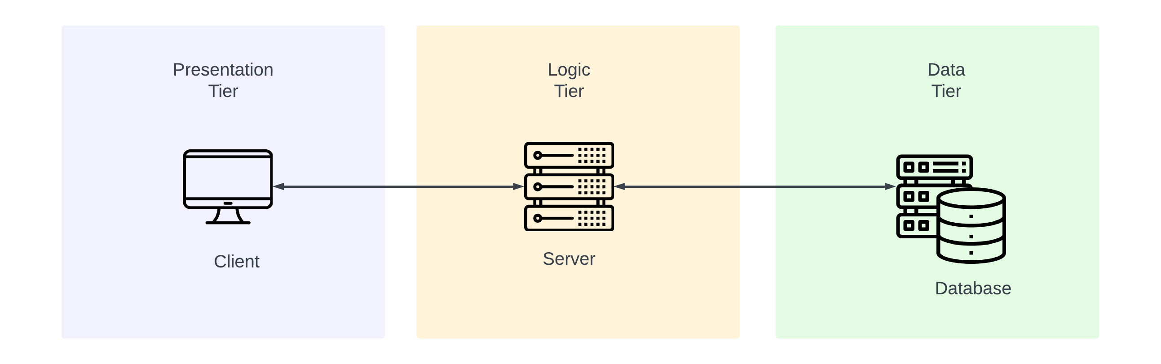

Server-Client Architecture
MVC Pattern

Slide 3
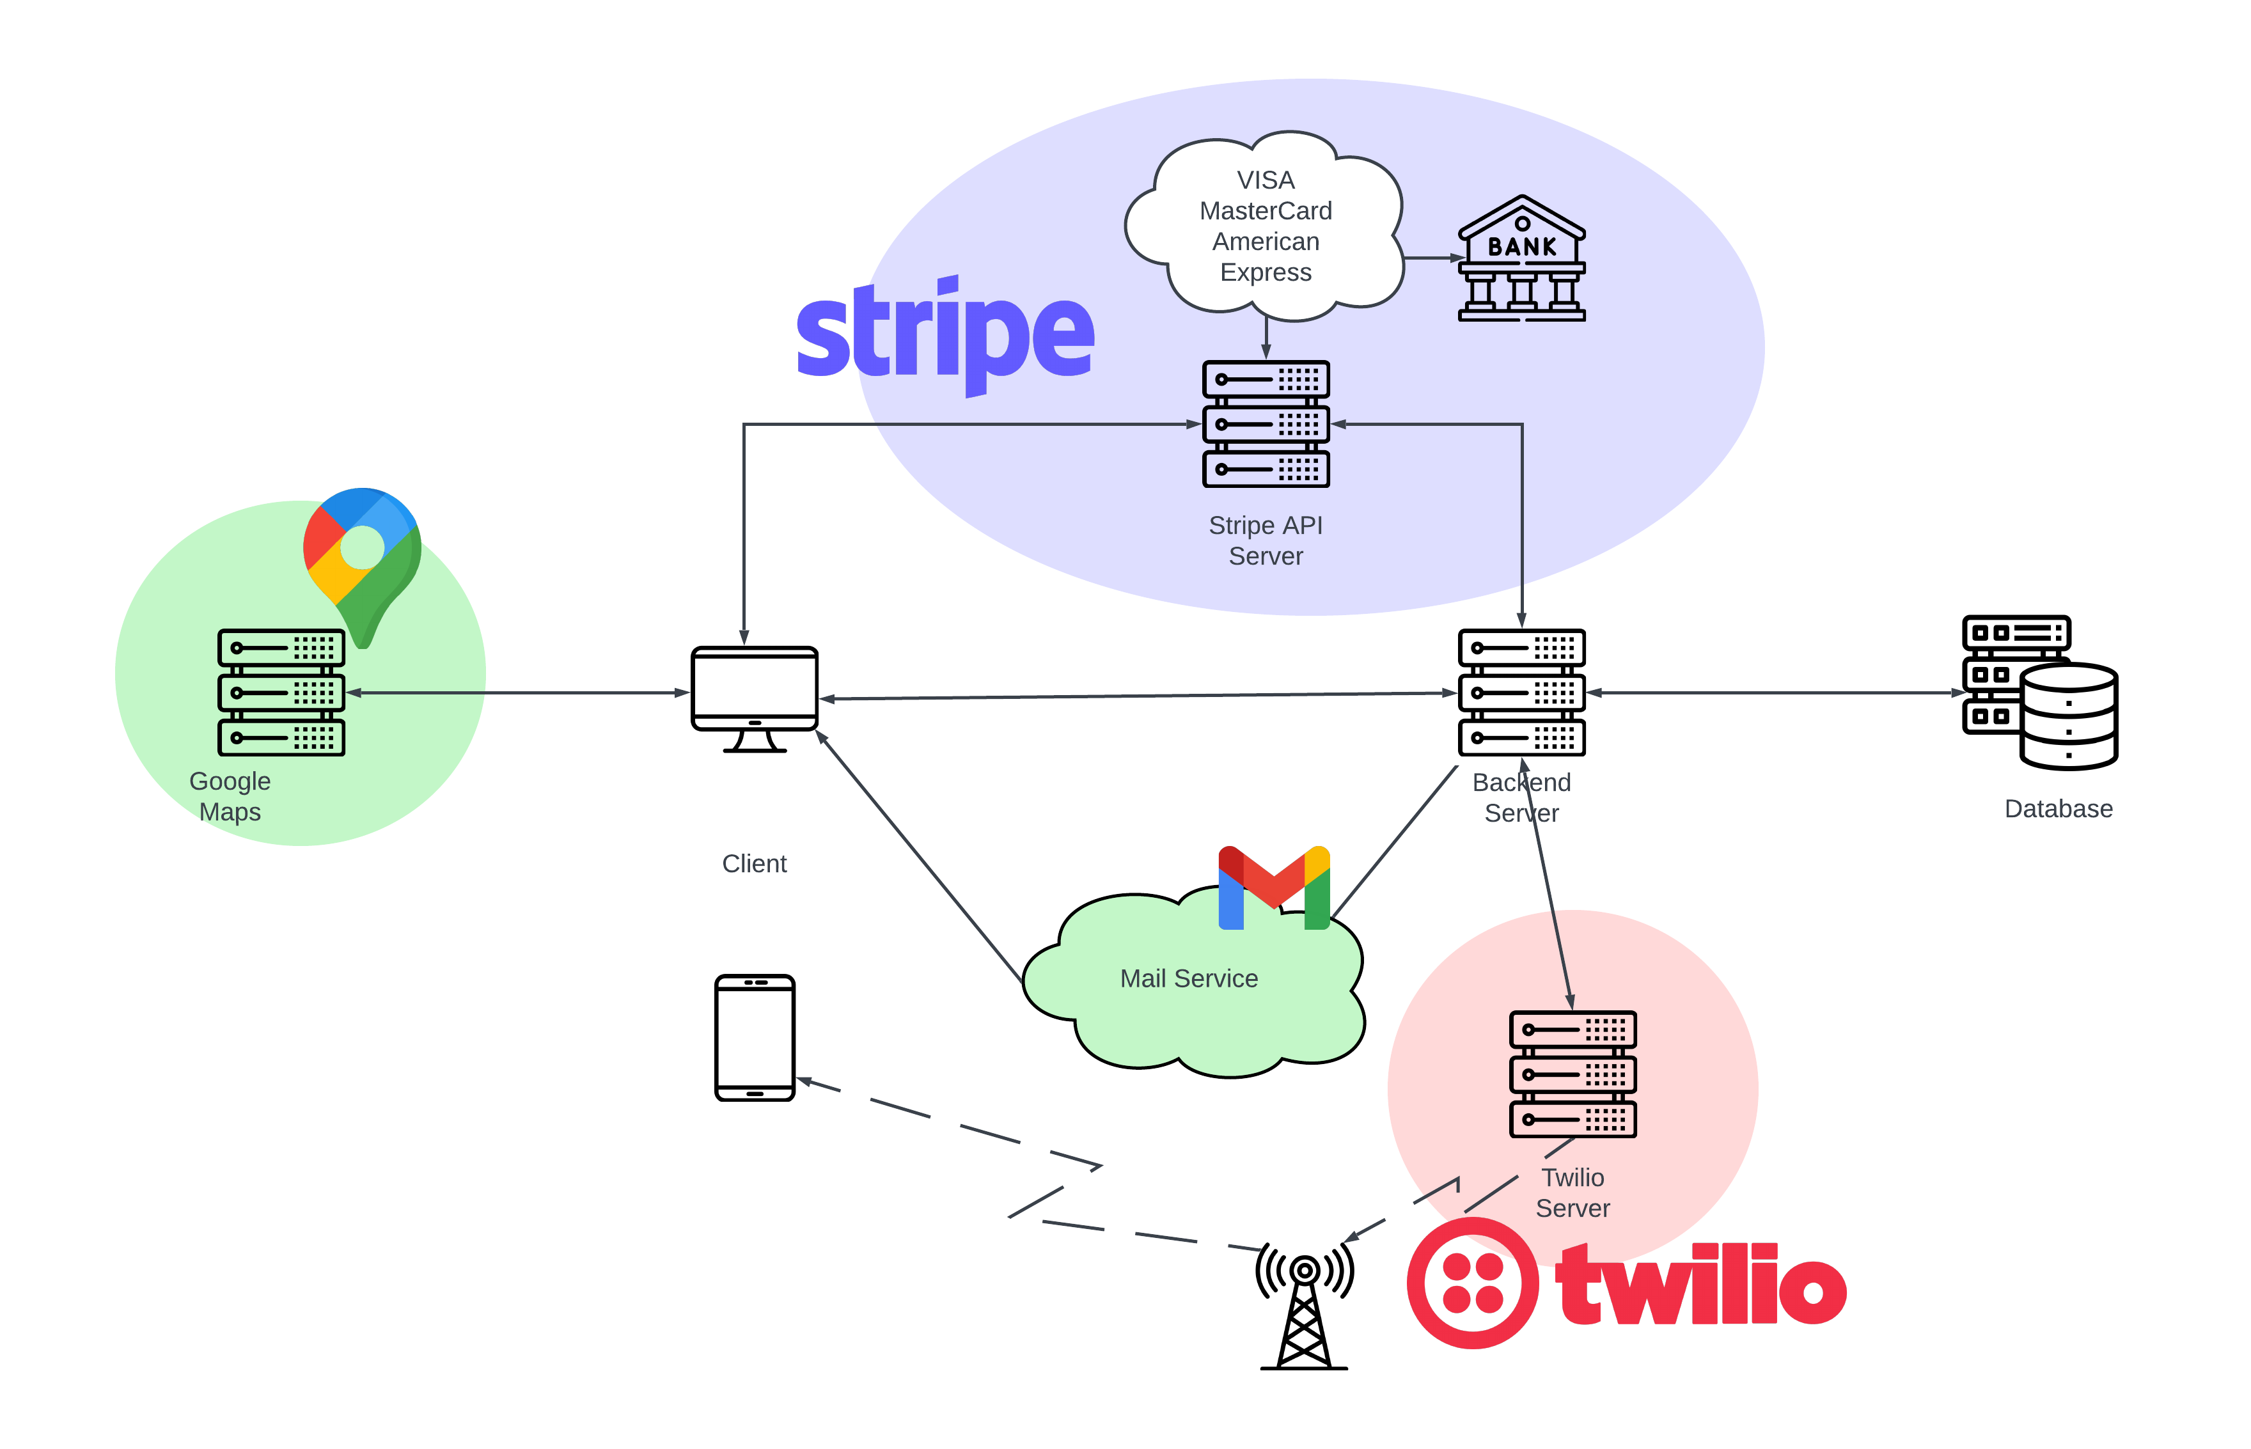

Slide 4
Architecture Overview
Data Tier:
Stores user, ads, promotions and transactions related info
Logic Tier:
Fetches and processes data from database, updates information.
Handles third party services for payment and verification.
Sponsored search through ticket scheduling
Admin side management
Presentation Tier:
Communicates with the other tiers through Application Program Interface (API) calls and shows necessary information through UI (user interface).

Slide 5
Tech Stack
Front-End : ReactJS
Back-End : NodeJS and ExpressJS
Database : PostgreSQL
ORM : Prisma

Slide 6
API Documentation
Postman Link

